Slide 1

FusionXperience
Sustainable Goal : Decent work and Economic Growth
Project Mentor : Mrs. Veena Trivedi
Group Number : 36
Group Members :
Gopal R. Vanjarani
Ved V. Shirur
Aditya S. Joshi
Gaurav R. Mahadeshwar

Slide 2
Content
Introduction
Problem Definition
Goals/Objectives
Survey of Existing system
Limitation of Existing system
Details of Hardware & Software
Proposed System : Introduction
Architecture/Framework (Block Diagram)
Methodology : Process Design
Implementation details(GUI Screenshot)
Future Scope
References

Slide 3
Introduction to Project
Event management is the strategic planning, organization, and execution of various types of events, ranging from small-scale gatherings to large-scale conferences. It involves a comprehensive approach to ensure that every aspect of an event, from conceptualization to post-event analysis, is meticulously planned and executed to create memorable and successful experiences for attendees.
Lots of factors need to be considered while making each decision. Also once the party is planned, A lot of on the day issues such as maintaining low noise levels after a particular time, or neighbors complaining about the noise levels etc. take the fun out of the party/event.
In order to manage such issues we require an easy to use website that will help in effectively tracking such problems. In this research work, We are going to make use of a website through which the event management is made feasible with the help of a fully automatic system.

Slide 4
Problem Definition
Event management has become increasingly complex and demanding, with a growing need for efficient, customizable, and user-friendly solutions. Existing event management systems often fall short in meeting the diverse requirements of event organizers, leading to several critical challenges.
Every Organization, whether big or small, has challenges to overcome and manage every event. Despite the growing demand for well-organized and memorable events, the event management industry faces challenges in ensuring consistent quality, efficient coordination, and seamless execution.
There is a pressing need for the development of a modern, comprehensive event management system that addresses these limitations and empowers event organizers to create successful, engaging, and memorable events.

Slide 5
Goals
Decent Work and Economic Growth :
Innovation and Technology -
Event management systems increasingly rely on innovative technology solutions. This can stimulate growth in the technology sector, leading to the creation of high-tech jobs and the development of new technologies that can be applied in various industries.
Entrepreneurship Opportunities -
Event management systems can support entrepreneurs who want to start their own event planning businesses. This can lead to economic growth through the creation of small and medium-sized enterprises (SMEs).

Slide 6
Goals
Reduction of Human efforts :
Automated Registration and Ticketing -
Event management systems can automate the registration process, allowing attendees to register online and receive e-tickets automatically. This eliminates the need for manual data entry and ticket distribution.
Data Management -
Event management systems collect and store attendee data, which can be used for analytics and reporting. This eliminates the need for manual data entry and analysis.

Slide 7
Literature Survey
Title | Abstract | Year / Journal | Reference Link
Study of Event Management Application | The aim of this paper is to discuss the services that will provide quality in processes of event management. The proposed system aims to use android application to effectively manage all the phases of event management process and provide user the ability to customize quality of event according to his/her taste or needs. | 2017, International Journal of Innovative Science and Research Technology | https://ijisrt.com/wp-content/uploads/2017/04/Study-on-Event-Management-Applications.pdf

Slide 8
Literature Survey
Title | Abstract | Year / Journal | Reference Link
Review paper on an Event Management System | Online event management system is a web application project that serves the functionality of an event manager. The system allow registered user login and new user are allowed to register on the application. The system helps in the management of events, users and the aspects related to them. The project provides most of the basic functionality as well as recommendations regarding various aspects of event. | 2017, International journal of Computer Science and Mobile Computing | https://ijcsmc.com/docs/papers/July2017/V6I7201711.pdf

Slide 9
Literature Survey
Title | Abstract | Year / Journal | Reference Link
Project report and research on online event management system | This project is an Event management portal that is implemented on a website. This project gives feature of remotely creating, removing, information retrieval, allotting task to different participants, etc. in an event. This project is capable of providing all the important access to the admin and all the people related to a particular event. It gives Event Manager access to see participants and guest list. | 2021, Turkish journal of Computer and Mathematics Education | https://turcomat.org/index.php/turkbilmat/article/download/9344/7199/16666

Slide 10
Literature Survey
Title | Abstract | Year / Journal | Reference Link
Event Management System | This system is an online software that serves the functionality of an event manager. The system allow registered user login and new user are allowed to register on the application. The system helps in the management of events, users and the aspects related to them. This proposed to be a web application. User needs to Login at the initial phase, set his/her profile details including location, choices, email-id, etc. | 2021, International Journal of Advance research and Innovative Ideas in Education | http://ijariie.com/AdminUploadPdf/EVENT_MANAGEMENT_SYSTEM_ijariie13806.pdf

Slide 11
Literature Survey
Title | Abstract | Year / Journal | Reference Link
Online Event Management System | As technology is growing rapidly we are also moving to a technical world where everything we want is to be online. The main aim of this proposal is to develop an online event management system. To analyze the current management system used by Event Planners in order to identify the system requirements. To gather requirements for designing Event Management System. | 2021, International Journal of Research publication and reviews | https://ijrpr.com/uploads/V3ISSUE7/IJRPR5912.pdf

Slide 12
Limitation of Existing system
Limited Customization :
Many off-the-shelf event management systems may have limited customization options. This can restrict your ability to tailor the system to meet the specific needs.
User Interface (UI) Complexity :
A complex or unintuitive user interface can lead to user frustration and decreased productivity. It's essential to identify any shortcomings in the user experience and suggest improvements.
Lack of Mobile Responsiveness :
In today's mobile-centric world, having a system that is not mobile-responsive can be a significant drawback. Users should be able to access and manage events on various devices seamlessly.
Cost and Licensing :
Some event management systems come with high upfront costs or ongoing licensing fees. This can be a limitation, especially for small businesses or organizations with budget constraints.

Slide 13





Software and Tools used
Python
Flask
MySQL
PHP
Streamlit-learn

Slide 14
Proposed System
We design an exclusive Event Management System. This is designed to assist in strategic planning and it will help to ensure that your organization is equipped with the right level of information and details of your future goals. Also for those busy executives who are always on the go, Our system comes with remote access features, which will allow you to manage your workforce anytime. These systems will ultimately allow you to better manage resources and events.
User Registration and Authentication : Users should be able to register and log in securely. Authentication mechanisms like email verification and password reset should be in place.
Event Creation : User should be able to create new events. This includes providing event details such as name, date, time, location, and event description.
User Profiles : Users and organizers should have profiles where they can manage their personal information, past event attendance, and event creation.
Feedback Loop : Continuously gather user feedback to make improvements and add new features to enhance the event management experience.

Slide 15
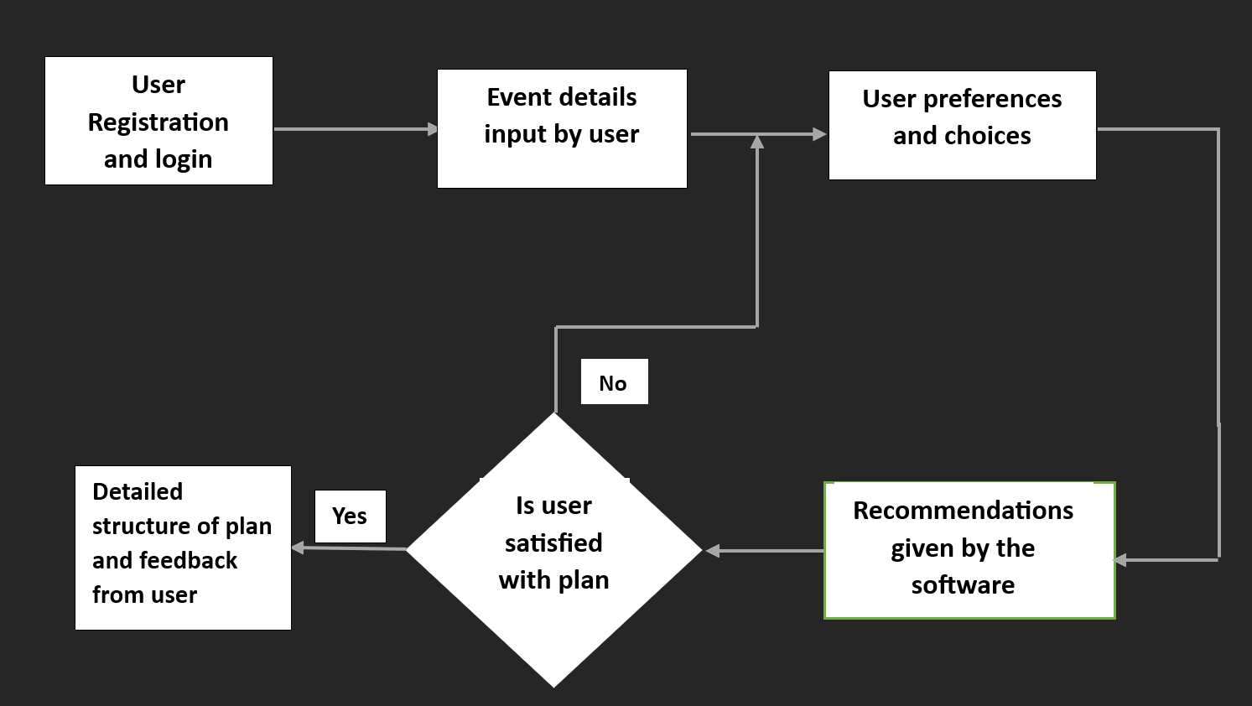
Architecture/ Framework (Block Diagram)

Slide 16
Methodology : Process Design
User Interaction :
User Input Gathering - The user interacts with the website by providing inputs such as event type, date, budget, location, and preferences.
Preference Analysis - The system analyzes the user's inputs, preferences, and constraints to understand the user's event requirements and expectations.
Recommendation Generation - Based on the analysis, the system presents the user with options and recommendations for venues, catering, decorations, entertainment, and other event elements.
User Feedback Loop - The user reviews the recommendations and provides feedback, allowing the system to refine its suggestions iteratively.
Final Plan Presentation - After multiple iterations, the system generates a detailed event plan, including vendor selections, timelines, and cost estimates, which it presents to the user.

Slide 17
Methodology : Process Design
Backend Operations :
Data Management - The system manages a database of event-related information, including venues, vendors, pricing, and user profiles.
Vendor Selection - The system uses a vendor selection algorithm to match user requirements with suitable vendors based on their availability, ratings, and pricing.
Cost Estimation - The system calculates the estimated cost for the event, taking into account vendor quotes, service fees, and other expenses.
Scheduling - A scheduling algorithm generates a timeline for the event, ensuring that tasks like booking, setup, and teardown occur at the right times.
Feedback Analysis - User feedback is collected and analyzed to continuously improve the recommendation engine and vendor selection process.

Slide 18
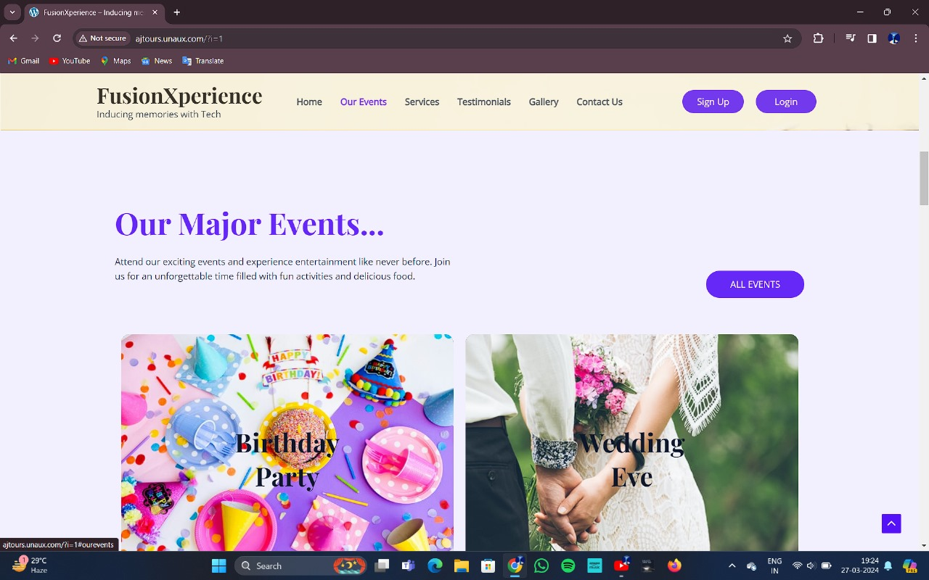
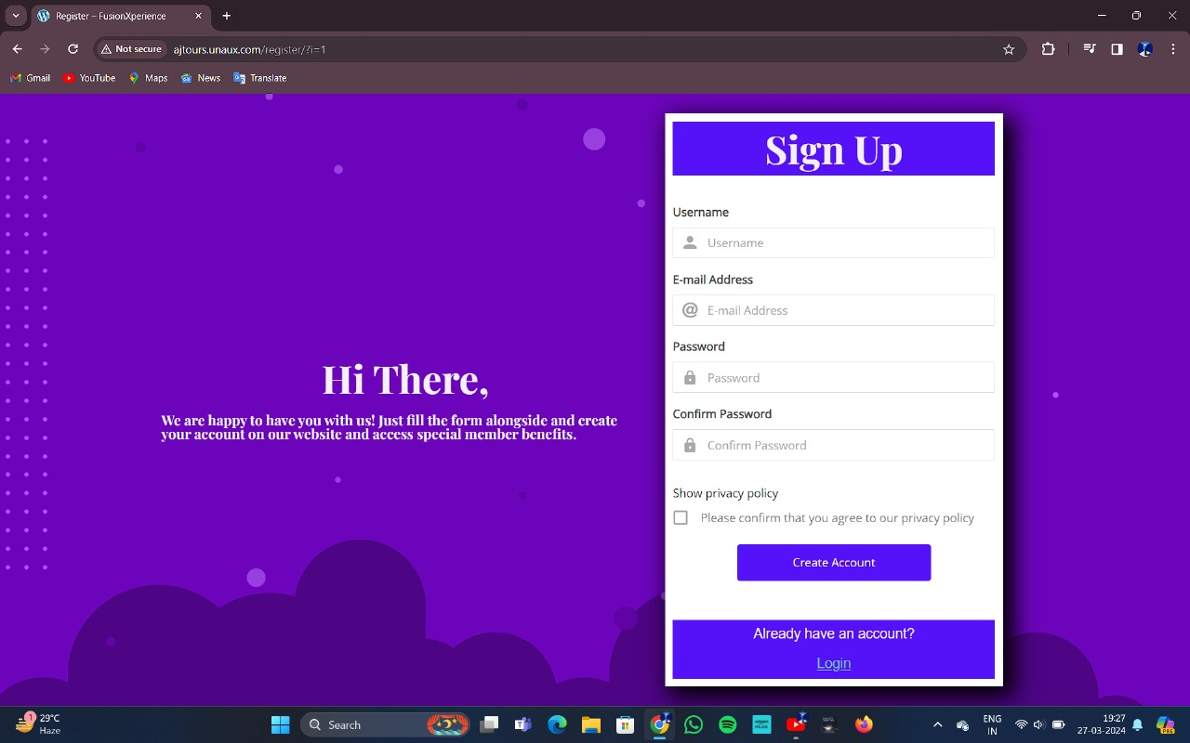
Implementation of the project :

Slide 19
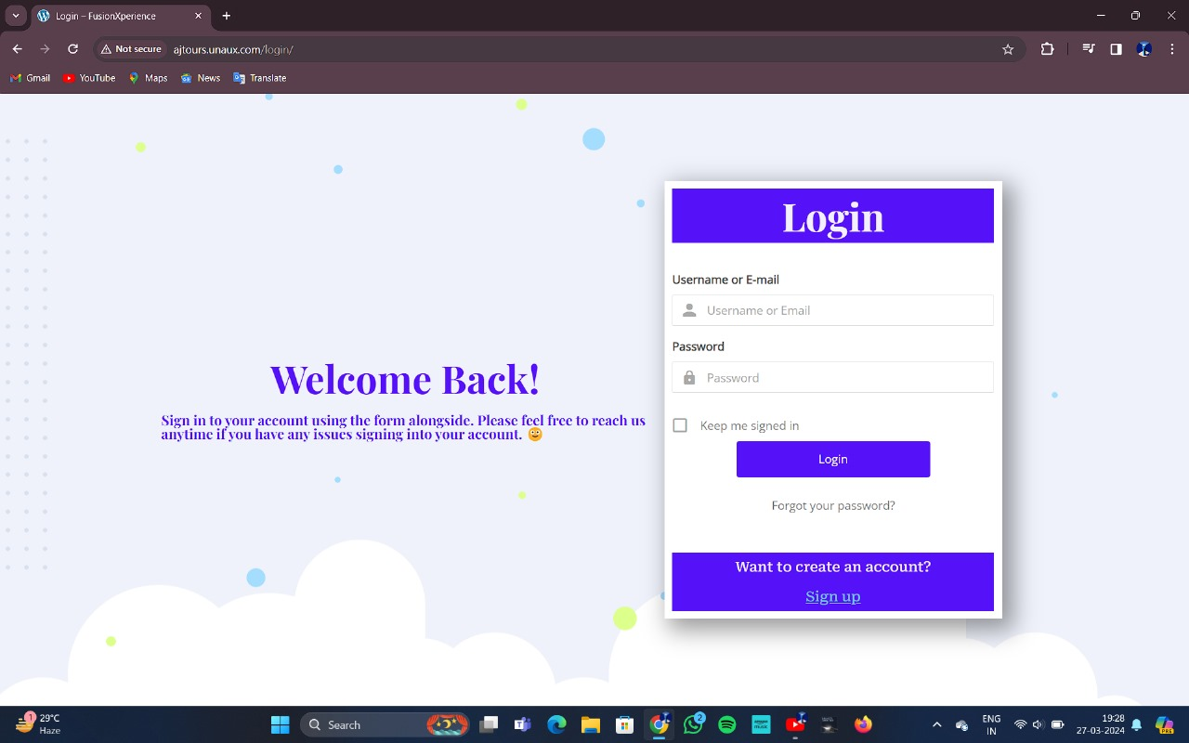
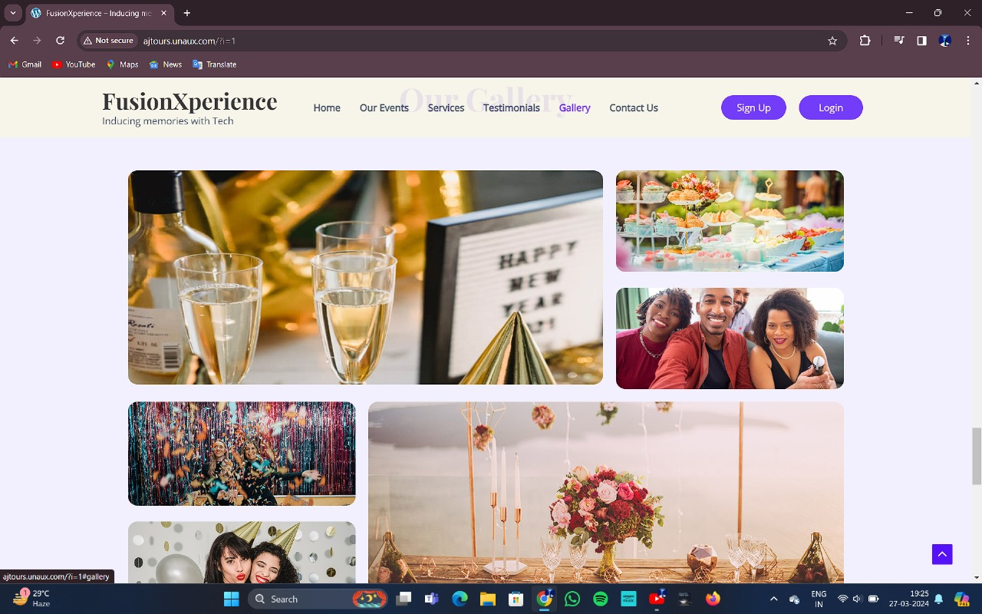
Implementation of the project :

Slide 20
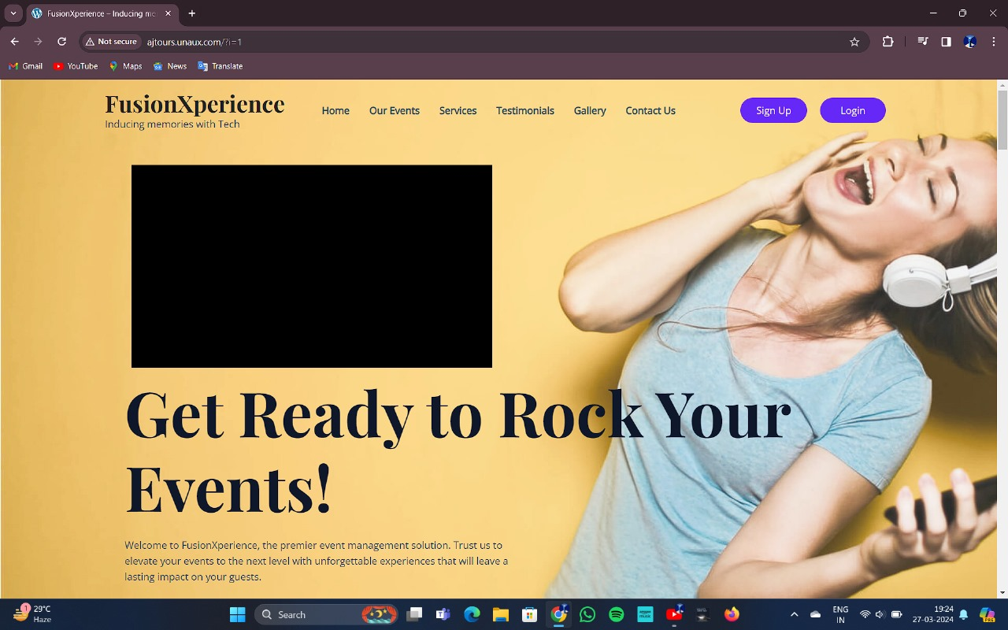
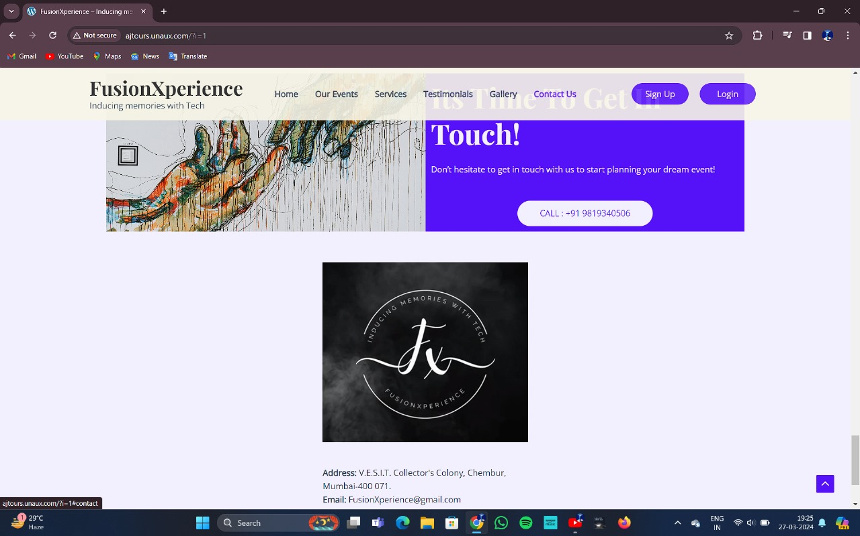
Implementation of the project :

Slide 21
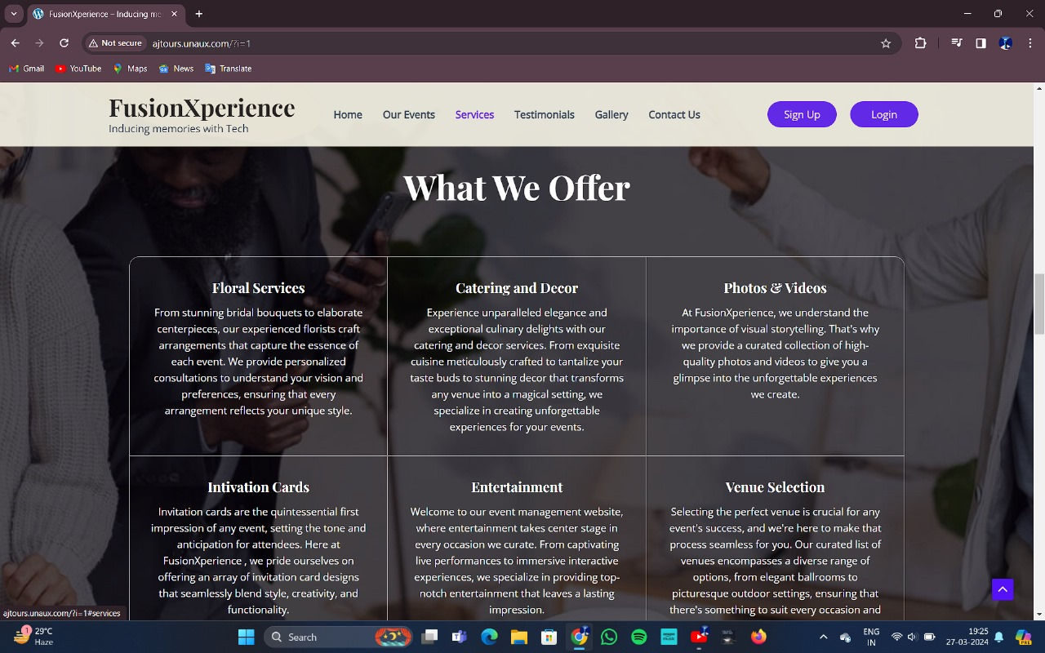
Implementation of the project :

Slide 22
Future Scope
In future, We are looking forward to make the following changes :
Enhanced User Experience -
Improve user interface (UI) and user experience (UX) design to make the system intuitive and user-friendly. Implement responsive design to ensure seamless access across various devices and screen sizes. We plan to enhance the user interface.
Database Management -
Implement proper database management system. The database should should include the users information as well as the Event related information such as the decorators, caterers etc.
Scalability and Performance -
Ensure the system can scale effectively to accommodate events of various sizes, from small gatherings to large conferences and festivals.
Automation -
Adapt the system to give automated event recommendations.

Slide 23
References
M.Mahalakshmi, S.Gomathi and, S.Krithika, “Event Management System”, 2016
Thomas, O. Reference Model Management, In Kelley, G. (Ed.), Selected Readings on Information Technology Management: Contemporary Issues, Hershey, New York, 2008.
Filman, R.E. et al. (Eds.) . Aspect-Oriented Software Development, Addison – Wesley Professional, 2004.
Parnas, D. L. On the Criteria To Be Used in Decomposing Systems into Modules, Communications of the ACM, 1972.
Sandeep Misal, Segar Jadhav, Tushar Jore , Archana Ugale ,”Event Management System.
Roozbeh Derakhshan, Maria E. Orlowska and Xue Li, “RFID Data Management: Challenges and Opportunities”, IEEE International Conference on RFID, 2007.
Theocharis, 2008, Special event management and event marketing: A case study of TKBL All Star 2011 in Turkey.
H. Sharma[2007-17] Event Education [Online]. Available:http://www.eventeducation.com.

